Slide 1
Feeding and Eating Disorders:
Facts, Fiction and Future
Phillip F. Bressoud, MD, FACP
Executive Director Campus Health Services
Associate Professor of Medicine
University of Louisville
Louisville, KY
January 27, 2012

Slide 2
Objectives
Review the common eating disorders
Review the approach to diagnosis and treatment

Slide 3
Disclosures
NONE

Slide 4

National Eating Disorders Association 2011
Grand Prize Winner: Savanna Dickinson
Lexington, KY

Slide 5
Overview
Prevalence
Disorders
Myths
Evaluation
Treatment
Future

Slide 6
Prevalence of Feeding and Eating Disorders in American
10 million women with anorexia or bulimia
1 million men with anorexia or bulimia
25 million men and women struggle with binge eating disorders
======
36 million Americans

Slide 7
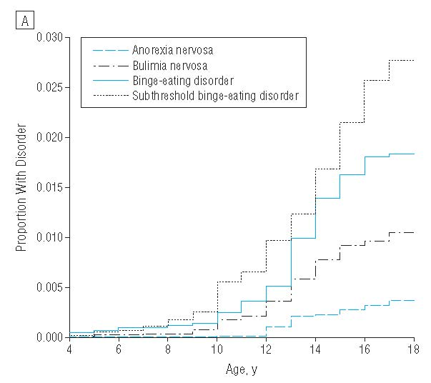
Cumulative Incidence Eating Disorders
Swanson Arch. Gen. Psychiatry68(7):714-723 2011

Slide 8
Eating Disorders Among College Students
NCHA Survey
  3% of females and 0.4% of males report diagnosis of anorexia
  2% of females and 0.2% of males report diagnosis of bulimia
  4% of females and 1% of males reported vomiting or taking laxatives to lose weight during 30 days prior to survey

Slide 9
Feeding and Eating Disorders
Risk Factors
Female gender
Adolescence and early adulthood
Family history
History of obesity
Stress
Affective disorders among 1⁰ and 2⁰ relatives
Bipolar disorder
Perceived pressure to be thin
Perfectionism
Impulsivity
Dieting

Slide 10
Overlapping disorders
Depression
Autism
ADHD
Schizophrenia
Bipolar Disorder
Obsessive-compulsive disorder
Obesity

Slide 11
Dieting and Thinness
49% of 9-11 year olds are “sometimes” or “very often” on diets
91% of college students attempted to control their weight through dieting
25% of American men and 45% of American women are on a diet on any given day

Slide 12
Dieting and Thinness
42% of 1st-3rd grade girls want to be thinner
81% of 10 year olds are afraid of being fat
Most fashion models are thinner than 98% of American women

Slide 13
Anorexia Diagnostic Criteria
Low body weight (<85% IBW)
Intense fear of gaining weight
Extreme focus shape/weight
Denial of illness or are not concerned
Amenorrhea (eliminated in DSM-V)
Incidence about 1% of females
Female >>> males

Slide 14
Anorexia
Highest mortality rate of any psychiatric disorder (5-10)%
Suicide Mortality Risk (SMR) 56.9; 95% CI 15-146
BMI <13 are at increased risk of sudden cardiac death

Slide 15
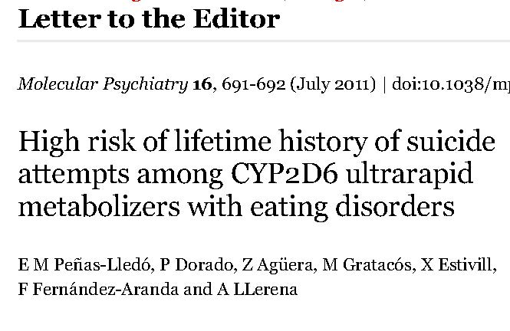
Anorexia

Slide 16
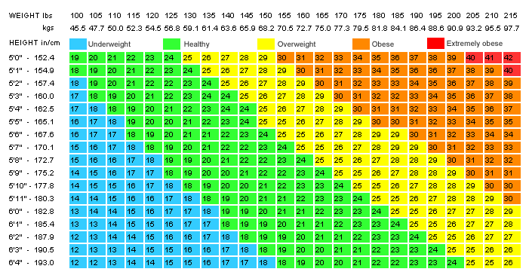
BMI Chart

Slide 17
Perceptions of Ideal Body Image
Women’s idealized BMI is about 20
As BMI decreases women rate themselves as more attractive

Slide 18

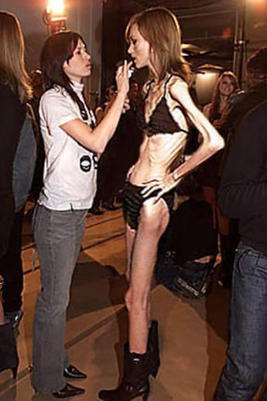
What Message are We Sending?

Slide 19
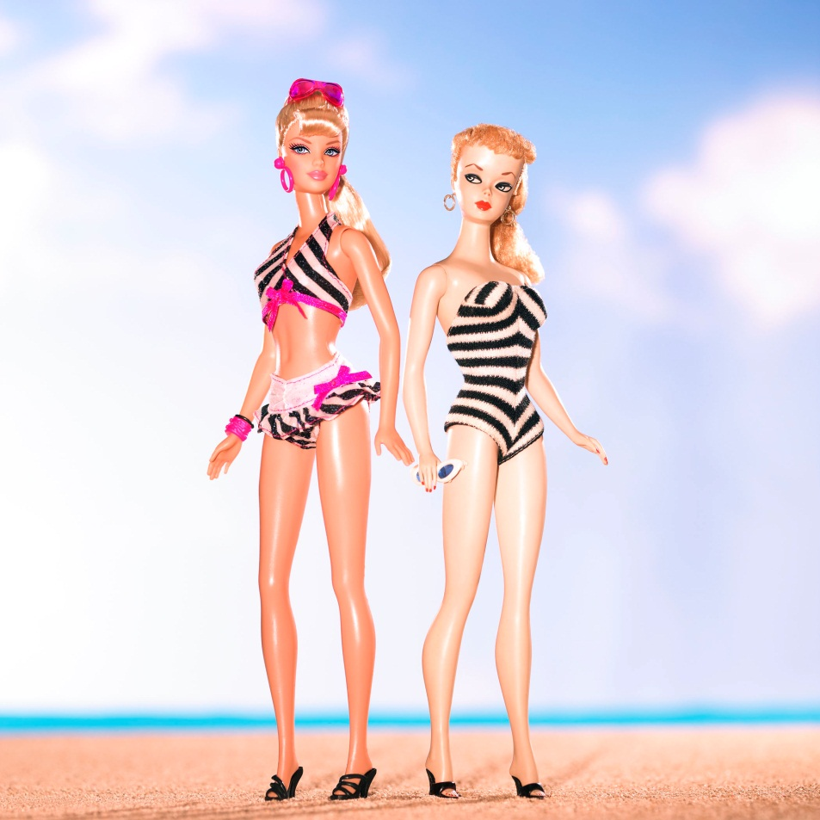
If Barbie Were Real
6’8”
38 inch chest
21 inch waist
36 inch hips
Virtually unattainable
Average US Woman 40-34-43

Slide 20
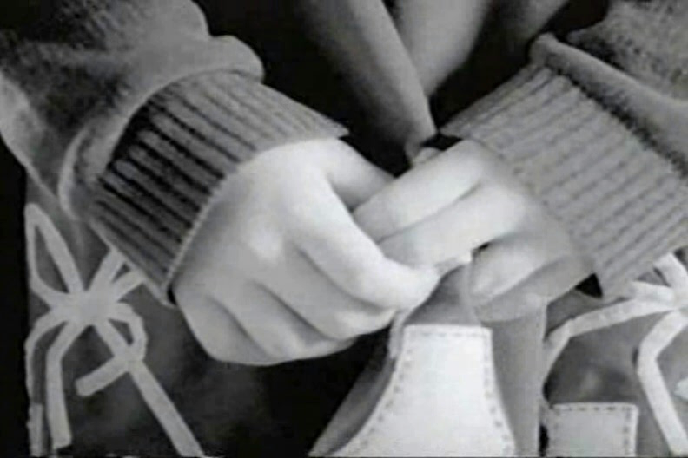

Slide 21
Anorexia
DURATION
•30% from 1-5 years
•31% from 6–10 years
•16% from 11-15 years
•77% from 1 – 15 years
AGE AT ONSET
•10% < or = 10 years
•33% between 11-15
•43% between 16-20
•86% by age 20

Slide 22
Anorexia
TRIGGERS
leaving home for college
termination or disruption of an intimate relationship
family problems
physical abuse
sexual abuse

Slide 23
Anorexia Nervosa Scenario
One hundred 12 year old girls
Same environmental exposure
Put all on a diet; nearly all hate it
One finds relief for anxiety and goes on to develop anorexia
  Anorexia relieves the anxiety
  The other 99 girls praise her for losing weight
WHY?

Slide 24
Anorexia
SCOFF Questionnaire
Are you constantly thinking about your weight and food?
Are you dieting strictly and/or have lost a lot of weight?
Are you more than 10% below your healthy weight?
Are people concerned about your weight?
IS your energy level down?
Do you constantly feel cold?
Scoring: 1 pt for each positive answer. Scores of > 2 highly indicative of anorexia or bulimia
Morgan et al. BMJ 319:1467-1468 1999

Slide 25
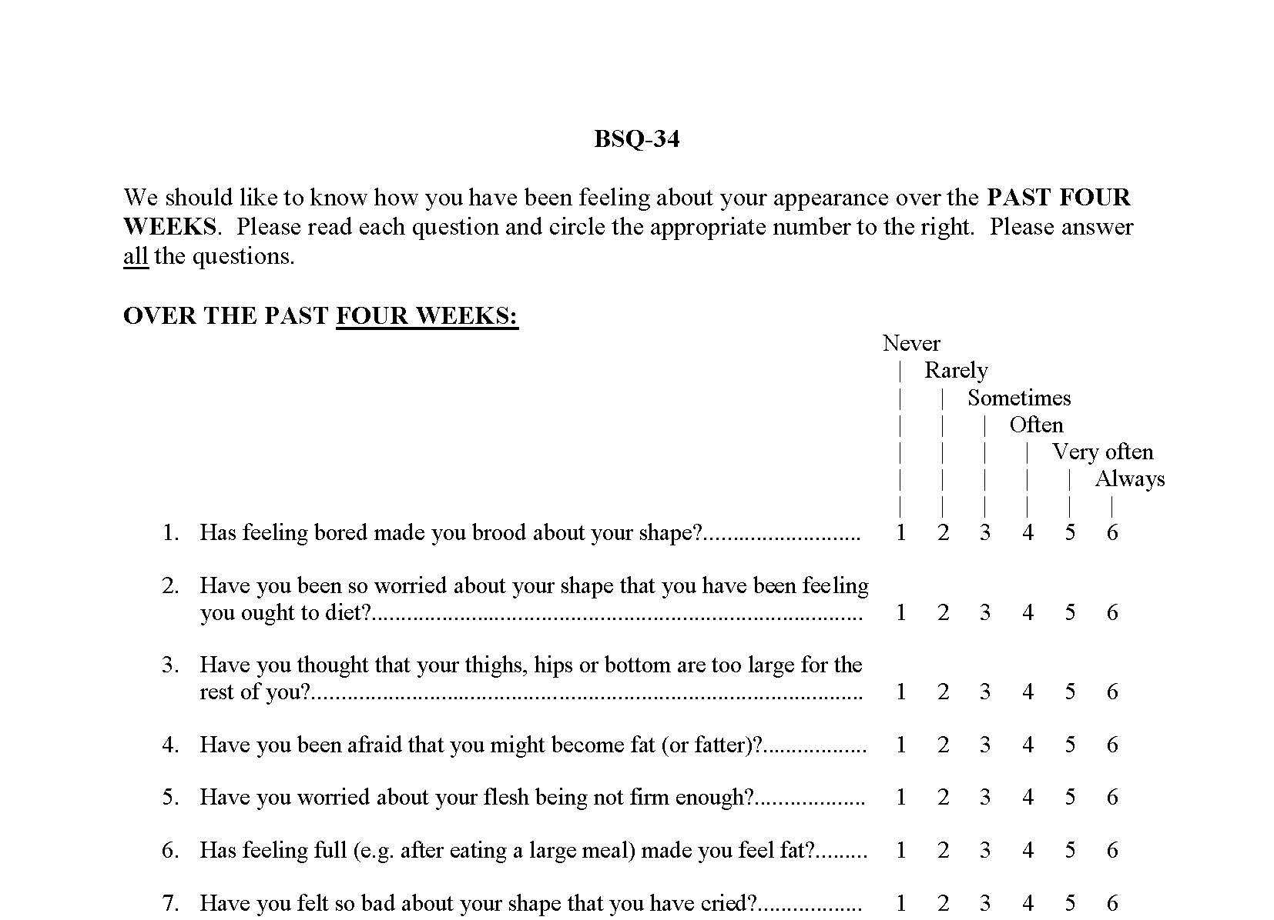
Body Shape Questionnaire (BSQ)

Slide 26
Prevalence of Symptoms on College Campuses
 | Undergraduates |  |  | Graduate
 | Female | Male | All | Female | Male | All
Positive SCOFF >3 | 13.5 | 3.6 | 9.4 | 9.1 | 3.1 | 5.8
Previous ED | 3.2 | 0.1 | 1.7 | 4.6 | 0.5 | 2.3
Previous AN | 2.2 | 0.1 | 1.2 | 2.7 | 0.3 | 1.4
Previous BN | 1.7 | 0.0 | 0.9 | 2.1 | 0.0 | 0.9
Previous ED DX with + screen | 5.4 | 0.0 | 4.3 | 14.0 | 6.2 | 11.7
Eisenberg et al J American College Health Association 59(8):700-707 2011

Slide 27
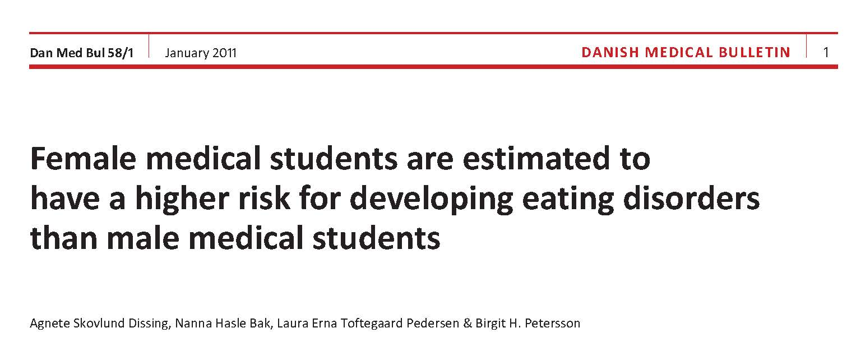

Slide 28
Signs and Symptoms
General
  Weight loss, failure to gain
  Cold intolerance
  Weakness
  Fatigue or lethargy
  Syncope
  Hot flashes or sweating
Oral and Dental
  Oral trauma or lacerations
  Perimolysis or Dental erosions
  Parotid enlargement
Cardiopulmonary
  Chest pain
  Palpitations
  Arrhythmias
  Edema
Dermatologic
  Hair loss
  Yellowish discoloration of skin
  Russel’s sign
  Poor wound healing
  Gastrointestinal
    Epigastric discomfort
    Early satiety, delayed gastric emptying
    GERD
    Hematemesis
    Hemorrhoids
    Rectal prolapse
    Constipation
  Endocrine
    Amenorrhea or irregular menses
    Loss of libido
    Low bone density
    Infertility
  Neuropsychiatric
    Seizures
    Memory loss/Poor concentration
    Insomnia
    Depression/Anxiety/BCD
    Self-harm
    Suicidal ideation/suicide attempts

Slide 29
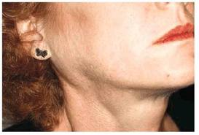

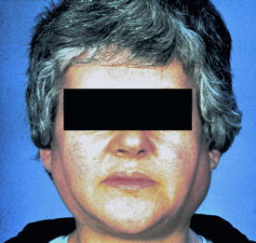

Slide 30
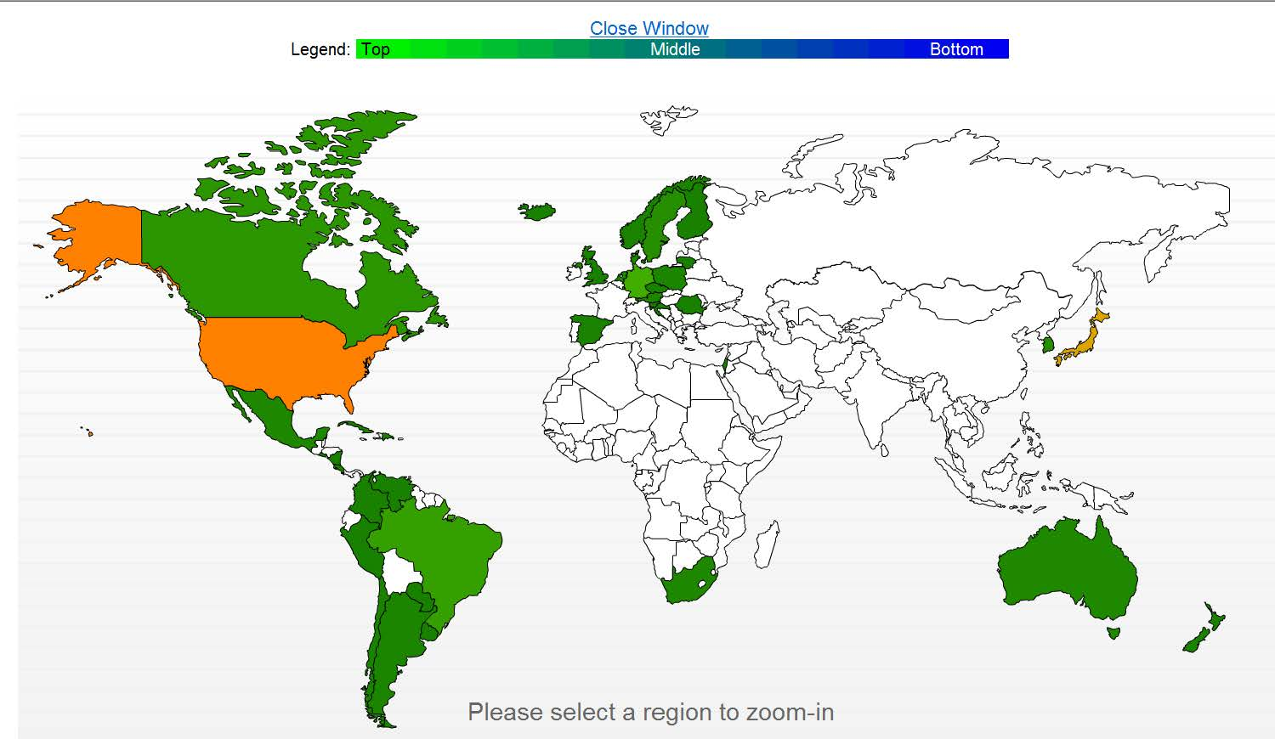

Anorexia Nervosa Morality
Source: www.mapnation.com

Slide 31
Bulemia Nervosa
Feeling out of control
Compensatory behavior
  Vomiting
  Excessive exercise
  Fasting
Extreme focus on shape/weight
1/week over 3 months
Affects 1.5-2% of females and
More common in females than males

Slide 32
Bulemia Nervosa
The average onset of Bulimia begins in late adolescence or early adult life
  Usually between the ages of 16 and 21
However, more and more women in their 30s are reporting that they suffer from bulimia

Slide 33
Bullimia
Two Subtypes
 | Characteristics
Purging Type | Self-induced vomiting and laxatives to control calories
Non-purging Type | Fast between episodes and excessive exercise to make up for the binge

Slide 34
Bulimia
usually begins in late adolescence or early adult life and affects 1-2% of young women
90% of individuals are female
frequently begins during or after an episode of dieting
course may be chronic or intermittent
for a high percentage the disorder persists for at least several years
periods of remission often alternate with recurrences of binge eating
purging becomes an addiction

Slide 35
Bullimia Nervosa
Common triggers for a binge
  dysphoric mood
  interpersonal stressors
  intense hunger after a period of intense dieting or fasting
  feelings related to weight, body shape, and food are common triggers to binge eating

Slide 36
Bullimia Nervosa
Feelings of being ashamed after a binge are common
  behavior is kept a secret
Tend to adhere to a pattern of restricted caloric intake
  usually prefer low-calorie foods during times between binges

Slide 37
Bulimia Scenario
100 12 girls
One is an early adapter
Smokers, drinks, diets, early sexual encounters, puberty arrives earlier
Notices her tendency to gain weight
Appetite “breaks through” diet
Impulsive and inhibited at same time
This one girl goes one to develop bulimia

Slide 38
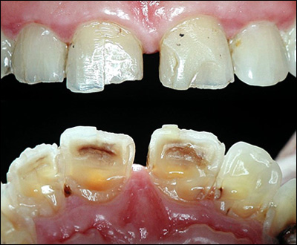
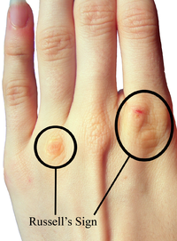
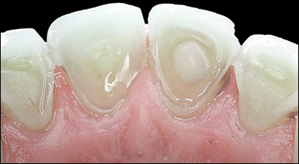

Slide 39
Binge Eating Disorder
Recurrent binge-eating
No regular compensatory behavior
Typically overweight or obese
Disturbed by binge-eating
3.5% of females; 2% of males
Females ≈ Males
1/week for 3 months

Slide 40
Eating Disorder Not Otherwise Specified
A female patient could meet all of the diagnostic criteria for anorexia nervosa except she is still having her periods
A person could meet all of the diagnostic criteria for anorexia nervosa are met except that, despite significant weight loss the individual's current weight is in the normal range.
A person could meet all of the diagnostic criteria for bulimia nervosa are met except that the binge eating and inappropriate compensatory mechanisms occur at a frequency of less than twice a week or for duration of less than 3 months.
The person could use inappropriate compensatory behavior by an individual of normal body weight after eating small amounts of food (e.g., self-induced vomiting after the consumption of two cookies). This variant is often called purging disorder.
The person could repeatedly chewing and spitting out, but not swallowing, large amounts of food.

Slide 41
Eating Disorder Not Otherwise Specified
Types
Binge Eating Disorder
Atypical Anorexia Nervosa
Subthreshold Bulimia Nervosa
Subthrehold Binge Eating Disorder
Purging Disorder
Night Eating Syndromes
Other Feeding or Eating Conditions Not Elsewhere Classified

Slide 42
Recurrent Purging Disorder
Recurrent purging
Absence of binge eating
Compensatory behavior
  Vomiting
  Laxatives
Affects 1.5-2% of females
Females>males

Slide 43
Binge Eating Disorder Scenario
100 12 year old girls
Two already have loss of control eating
>100 percentile in weight
Early puberty
They develop binge eating disorder

Slide 44
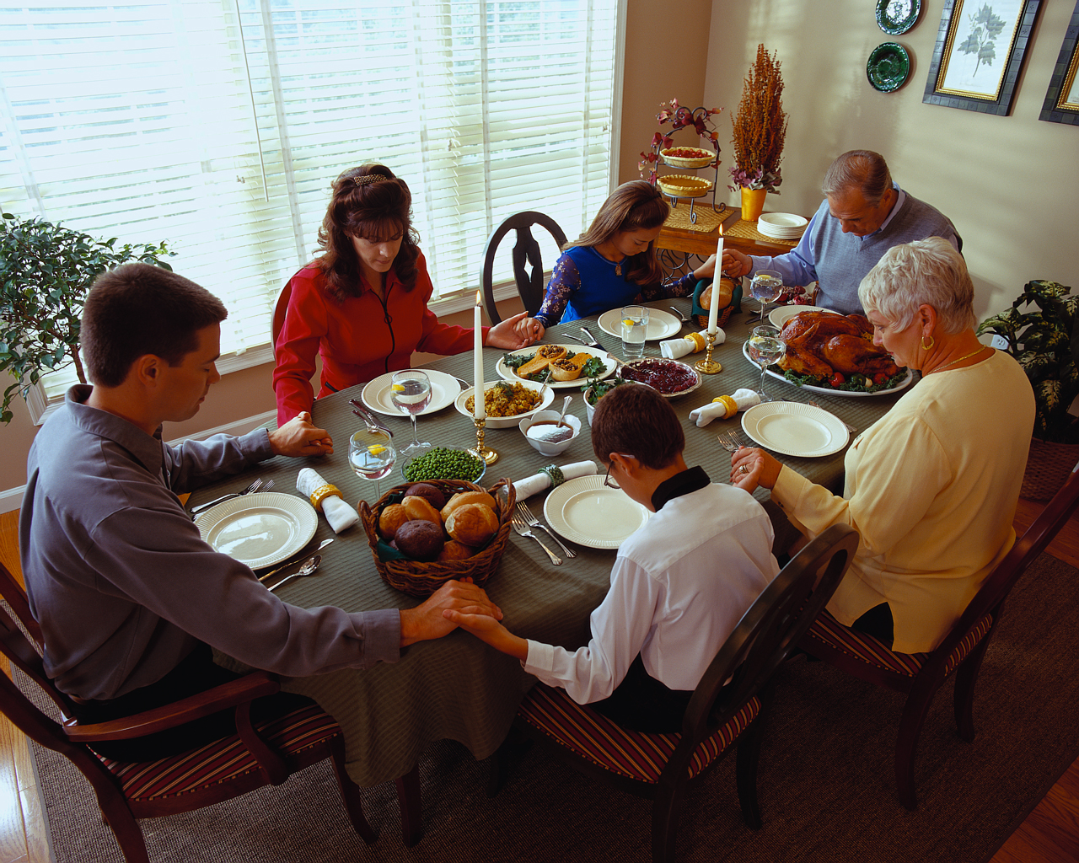
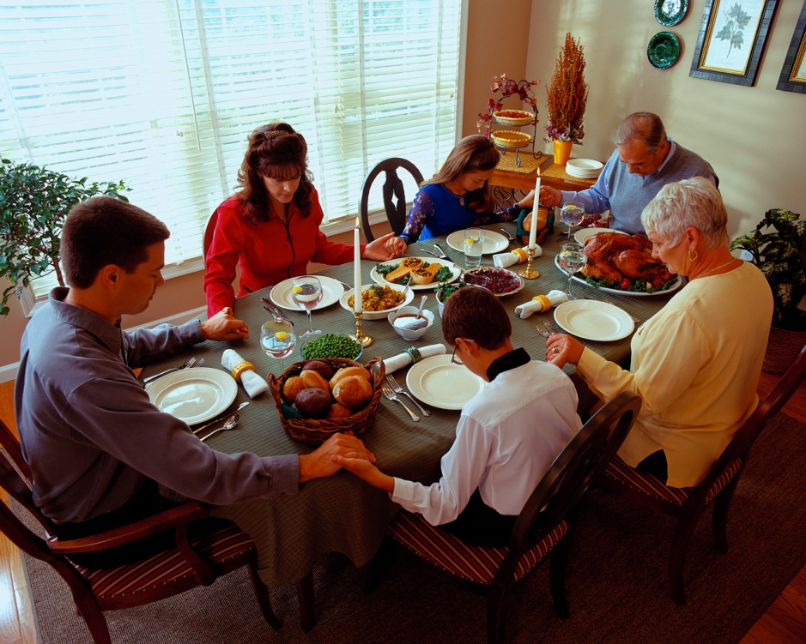
Myths: Restrictive food choices

Slide 45

Myth: Anorexia is a choice

Slide 46
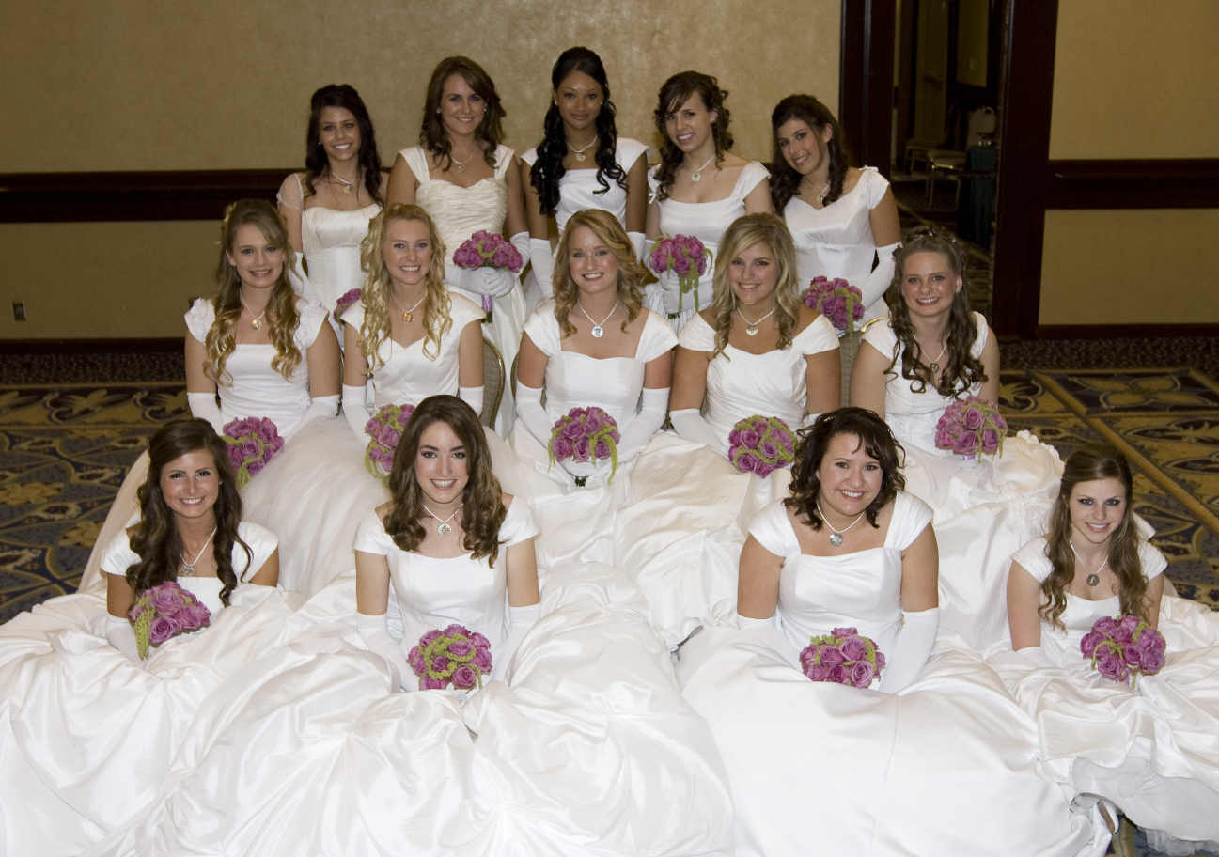
Myth: Anorexia is UMC disease

Slide 47






MYTH: Society is to blame

Slide 48

Myth: Mothers are to blame

Slide 49
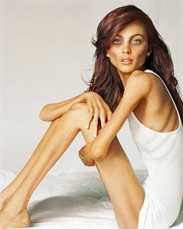

Who is healthy?

Slide 50
Genetics
Easting disorders run in families
  RR for anorexia 10-20
  RR for binge eating >2
  WHY???????
Twin Studies
  Eating disorders are inheritable (1⁰ Swedish studies)
    40-80% of anorexia and bulimia
    40-60% of binge eating disorders
Linkage Studies
  AN chromosome 1
  BN chromosome 10
Genetics Consortium for Anorexia Nervosa
  genotyping patients from all over the world– Results?

Slide 51
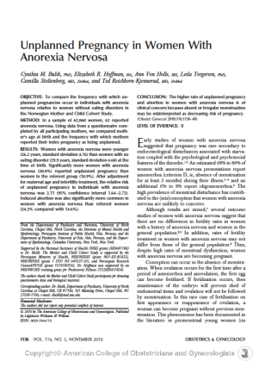
Pregnancy and Anorexia
Relative risk of pregnancy is 2.1
AN 24.6% had induced abortions

Slide 52
Binge Eating during preganancy
 | Est BED->BED | New Onset BED
Total calories | ⬆ | ⬆
Total Fats | ⬆
Monosaturated Fat | ⬆ | ⬆
Saturated Fat | ⬇
Folate | ⬇
Vitamin K | ⬇
Vitamin C | ⬇
Cakes/Candy | ⬆ | ⬆
Milk Desserts | ⬆ | ⬆

Slide 53
What happens to ED during pregnancy?
Bulimia goes down
Binge eating disorder goes up
EDNOS goes down
New onset binge eating in lower socioeconomic groups

Slide 54
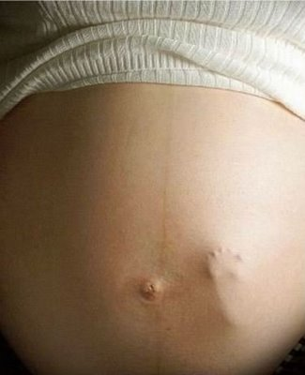


Myth: Anorexics can’t get pregnant
2008

Slide 55
Perinatal Factors
Pregorexia
  Inadequate gestational weight gain
    Preterm birth
    Low birth weight
    Premature
    Stillbirth
    Increased cesarean
    Low apgar scores
Just under nutrition?

Slide 56
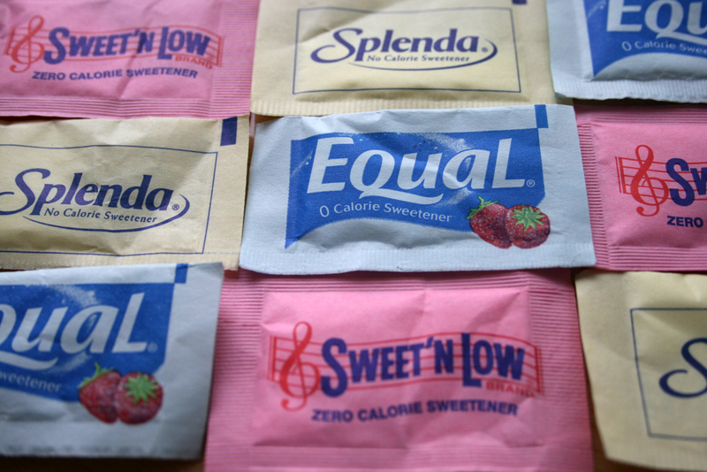

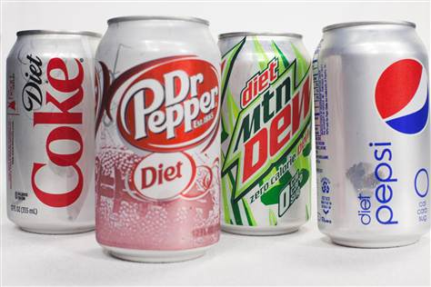
Regardless of Eating Disorder Pregnant Women Liked More Artificial Sweeters

Slide 57
Pregnancy Summary
Remission for some BULEMIA
Risk for others BED
Weight trajectories are different for all
Bulimics and Binge Eaters actually restricted their children’s food intake
Anorexics very selective in what they feed. Organic, prepared in the home, etc.

Slide 58
Medical Evaluation
No specific tests to diagnose
History
  History of body weight
  History of dieting
  Eating behaviors
  All weight-loss related behaviors
  Past and present stressors
  Body image perception and dissatisfaction
  Medical History
physical exam
Screening tools
Selected laboratories
DEXA Scan if amenorrheic for more than 6 months

Slide 59
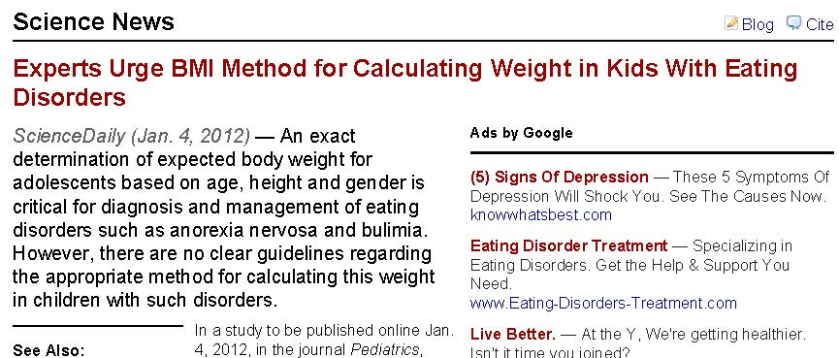
Measure BMI

Slide 60
Screening Tools
SCOFF
EAT (Eating Attitudes Test)
EDI-2 (Easting Disorder Inventories)
FRS (Figure Rating Scale)

Slide 61
Feeding and Eating Disorders
Differential Diagnosis
Malignancy
CNS tumors
Inflammatory Bowel Disease
Celiac Disease
Diabetes mellitus
Hyperthyroidism
Addison’s Disease
Immunodeficiency
Chronic Infections
Affective Disorders
OCD
Body dysmorphic disorder

Slide 62
Treatment options
Inpatient hospitalization
Outpatient psychotherapy (CBT)
Medication (SSRI’s)
Self-help/Support Groups (A/B, OA)
Family therapy
Nutritional education
Stress management

Slide 63
Treatment
Anorexia
  Treatment is ideally multidisciplinary
  Psychotherapies are the primary treatment
  Pharmacotherapy is generally used as an adjunctive treatment and then for comorbidity
Bulimia
  Antidepressants decrease frequentcy of episodes
  Combined drug and CBT are synergistic
  SSRI first line drugs
    Bupropion is contraindicated because of association with seizures in those who purge
Binge Eating Disorder
  Pharmacotherapys alone can be effective
  Topiramate effective but poorly tolderated

Slide 64
FUTURE: Gastrointestinal Hormones
Ghrelin
  Hormone produced in oxyntic cells of the stomach and pancrease which increases food intake and fat deposition
  Levels typically high in AN with a paradocaclly decreased postprandial levels
Peptide YY
  A neuropeptide from the “Y” family
  Produced in the distal ileum and colon
  Levels increase following a meal and play a role in meal terminiation and satiety
  Higer levels in patients with ED
GLP1
  Acts as a hormone and transmiter
  Acts as an anorexant by suppressing appetitie and slowing gastric emptying.
  Levels lower in anorexia patients than normals.
Tong et al. Current Opinion in Endocrinology, Diagetes and Obesting 18:42-49 2011

Slide 65
Conclusions
Eating disorders are relatively common clincal problems
Obtain dietary and body image histories in high risk populations
Measure and document BMIs
Use screening tools such as SCOFF
Refer to mental health evaluation early
Use pharmacological therapy selectively in AN and combination treatment in Bulimics
Consider birth control for anorexics

Slide 66
Resources
  Academy for Eating Disorders www.AED.org
  National Eating Disorders Association www.NEDA.org
  http://www.prettythin.com/

Slide 67
