Slide 1
Unique Challenges for Female Sex and Love Addicts Making Advances
CAPTASA Conference 2013
Susan J. Campling RN,PsyD

Slide 2
Disclosure
Co-Author, Making Advances
Executive Director Magnolia Creek
Board Member Society for the Advancement of Sexual Health

Slide 3
Objectives
Understand current research regarding FSLA
Outline best practices for FSLA
Identify tools of recovery

Slide 4
History
2008-2009 Women’s Summit met to discuss FSLA and treatment issues
Initially identified the need for an appropriate female centered assessment toll which asked questions regarding issues more often found among women
Identified need for further research so the assessment was converted into a tool that was placed on Survey Monkey
N= 471

Slide 5
Women are different then men
Brains are different
Socialization is different
History is different
Interpersonal interaction is different
Addiction experience is different and treatment needs to reflect these differences
Women do better when their therapist is sensitive to their attachment history, trauma and attachment needs
The client must feel safe and secure and heard
Resources are limited for women especially mothers and caretakers
Traditional focus is often upon single issues and many programs do not want to look holistically at the patient

Slide 6
Neuro-attachment Factors
Attachment wounds in infancy result in vulnerability to later MDD, PPTSD, schizophrenia and BPD (Roth & Sweatt, 2011)
Attachment failure and neglect may be more harmful than violence or abuse (Field, Diego, Hernandex-Reif, 2016)
At 8 weeks of fetal development testosterone surges alter cell growth in the communication centers of the brain. Females fetuses do not experience these changes.
Female brains remain structured for social connection.
Attachment is a major factor in affect regulation skills especially I females.
FSLA is defined by some as “a regulation impairment due to fundamental attachment disorder”.

Slide 7
Environmental Social Factors
Family systems- Family messages about sex, women, value, Modana Whore
Mother hunger and Wounding- (attachments wounds from first love, Kelly)
Trauma (Carnes) 97% of SA have emotional trauma, 81% sexual trauma, 72% physical abuse (male and female data)
Schwartz and Southern found that among women in treatment, 76% had a history of sexual trauma and refusing unwanted advances, 43 substance abuse histories and 68% eating disorders (2000)

Slide 8
Corley and Hook 2012
Women are more likely to enter into relationships on social network sites such as Facebook and/or play social interaction games such as Second Life
Women use the internet for fantasy and relationships while men use it to stimulate for masturbation
Women are more likely to keep their online behaviors a secret

Slide 9
Women’s Sexuality Survey (Study reported by Corley and Hook 2012)
14% of women in study reported cybersex as problem
Women in this group reported more time online and reported more symptoms than the addicted/no cybersex group
79.3% of that group reported frequently visiting porn/and chat rooms
57% of that group reported relying on abusive porn/fantasies to feel aroused

Slide 10
Women’s Sexuality Survey
70% of FSLA reported feeling degraded by their sexual behavior as opposed to 32% of non-addicted women
37% reported having faked orgasms to please partners
Women who use internet for sexual purposes or have sexual fetishes report high shame because of the taboo
High degree of relational difficulties
Damaging relationships

Slide 11
Women, Technology and Social Networking Sites
Internet use by men and women tend to be different
Men use porn for arousal;
Women use social sites and games for erotic connection
Women are more likely to go meet someone they “met on-line”
Internet information shapes attitudes, values, behaviors Raises the question what is normal?
Offers perception of “safety” and “anonymity”
Creates Conversation: Facebook, My Space, etc.

Slide 12
Women, Technology and Social Networking Sites
Find Dates: Match, plentyoffish, eHarmony, OkCupid, True, DateHookUp, FriendFinder, Jdate
Creates Secrets: Ashley Madison, Married Secrets, lonelyhousewives, Xanga
Provides Opportunities for Interactive Sex (teledildonics / cyberdildonics): Fleshlight, Sinulator, realtouch
US Facebook crime statistic are difficult to track however the UK reports a 7000% increase in crimes associated with Facebook

Slide 13
Women and Eating Disorders
Generally, patterns of drug use, eating disordered behavior and sexual behaviors all follow similar pathways, arousal, satiety, or mixed
Fantasy is also a key issue in ED with SA
“No one will love me unless I am …
My body must be right.
He will not want me if I am not thin/pretty/have large breasts/…
Notes:
Similar self talk in SA and ED

Slide 14
Case Example I- Mary
25 year old, single woman
Restrictive eating disorder behaviors since age 13
Covert incest. Early exposure to pornography (age 5)
Began cocaine 4 years ago while in college to lose weight
Dropped out of college due to cocaine; Sex worker (real & virtual)
Perfectionistic high achieving in school, very smart
S+M sexuality, hypersexual- masturbates 3-4 times per day

Slide 15
Case Example II- Jean
30 year old single woman
Restricting and purging ED
Texting, sexting, compulsive phone use
Cosmetic surgeries ($ by partner)
Alcoholic
Parents knew she was going to sex cubs with her boyfriend and condoned it.
Trauma bonded in romantic relationships- “best friend, treats me wonderfully”. (He raped her, drugged her and watched her have sex with other women. Acts as her pimp. Sexual sadist)

Slide 16
Now What?
Treating female SLAs is no easy task.
The therapist must be:
Sensitive
Supportive
Skilled
SAFE

Slide 17
Treatment Differences
Tasks are critical to healing damaged brain chemistry and maintaining healthy relationship skills.
Men and women have different brains and approach tasks differently.
Females respond better and are more likely to complete tasks in the therapy room; she wants to connect (not just complete a task) and will use both sides of her brain.
Giving her “just homework to do” makes it likely she will feel dismissed and increase her shame so she can’t do the task.

Slide 18
Tools for the Life History
Genogram
Art
Dance
Music
Poetry
Narrative History
Trauma Egg / Timeline
Journaling
Psychodrama
Descansos (Pinkola-Estes, 1992)
Teletherapy & Parallel Process

Slide 19
Comprehensive Life History
Telling the Story Gives Voice
Provides a vehicle for change
Helps clients process feelings, break through denial and explore grief
Challenge distorted thoughts and core beliefs
Transform suffering into meaning
Feel connection with therapist
Notes:
Carol Gilligan

Slide 20
Comprehensive Life History
Genogram / Family Map - outlines historical and current family relationships, including information about addictions or dysfunctions.
Gather information quickly
Identify players
Recognize attachment wounds
Find support networks

Slide 21
Addressing Shame
Narrative therapy begins the process of “shame resilience” and story-claiming.
Who do you become when you’re backed in to a shame corner?
How do you protect yourself?
Who do you call to work through the mean-nasties or the cry-n-hides or the people-pleasing?
What’s the most courageous thing you could do for yourself when you feel small and hurt?
Brene Brown 2010

Slide 22
Worthiness
“I realized that only ONE thing separated the men and women who felt a deep sense of love and belonging from the people who seem to be struggling for it. That one thing is the belief in their worthiness. It’s as simple and as complicated as this: IF we want to fully experience love and belonging, we must believe that we are “worthy” of love and belonging.”
Brene Brown (2010)

Slide 23
Tools of Recovery
Complete a comprehensive Life History.
12-Step support (SA, SAA, SLAA, SCA, CSA, SRA, RCA) - including getting a sponsor, working the Steps and connecting with others / a sponsor, daily.
Disclosure as necessary.
Reading recovery literature.
Eat, pray self-love
Anger work
Medication
.

Slide 24
Tools of Recovery
30 Tasks (Carnes model) - including assessments and arousal template. Do this in session if needed.
Recovery Circles - identify bottom-lines (sobriety), limits, triggers, rituals and self-care boundaries.
Celibacy or Abstinence Contract - including no dating or participating in any erotic relationships.
Teletherapy.
Dating timeline (Katehakis) and Healthy Sexuality Model (Manley), and…

Slide 25
12-Step Support
Difference in “S” Group recovery for women
Women among women - friend or foe?
Finding a sponsor - learning accountability
Working the steps
What’s God got to do with it?

Slide 26
Tools of Recovery

Slide 27
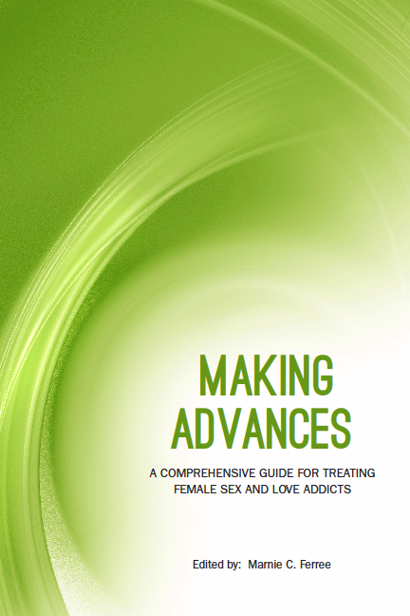
Making Advances A Comprehensive Guide for Treating Female Sex and Love Addicts
Edited by Marnie C. Ferree
Writers:
Susan J. Campling
Robin Cato
M. Deborah Corley
Marnie C. Ferree
Linda Hudson
Alexandra Katehakis
Kelly McDaniel
Anna Valenti-Anderson
Jill Vermeire
Sonnee Weedn
All proceeds benefit the Society for the Advancement of Sexual Health
www.sash.net/makingadvances

