Slide 1
Dr. Adair, Is Marijuana really addictive? J. Randle Adair, D.O., Ph.D. Diplomate, American Board of Internal Medicine Certified, American Society of Addiction Medicine CAPTASA 2014

Slide 2
Components of addiction:
Use
Abuse
Tolerance
Continued use despite consequences
Presence of a defined set of symptoms upon cessation

Slide 3
The Cannabis Withdrawal Scale development: Patterns and predictors of cannabis withdrawal and distress. Allsop, DJ, et al., 2011. Drug and Alcohol Dependence, 119: 123-129

Slide 4
Background:
160 million current users worldwide
2.1 million new users annually
10% of users will become dependent
1:2 odds of dependence with daily users

Slide 5
Participants (n = 49 completed):
Inclusion criteria:
Usage 5 or more days/week in past 3 months
Cannabis dependence (DSM IV)
Previous experience of at least one withdrawal symptom
Willingness to quit for 2 weeks

Slide 6
Method:
Baseline assessment
One week daily smoking
Quit session
CWS questionnaire daily (26 items)
Urine sampling

Slide 7
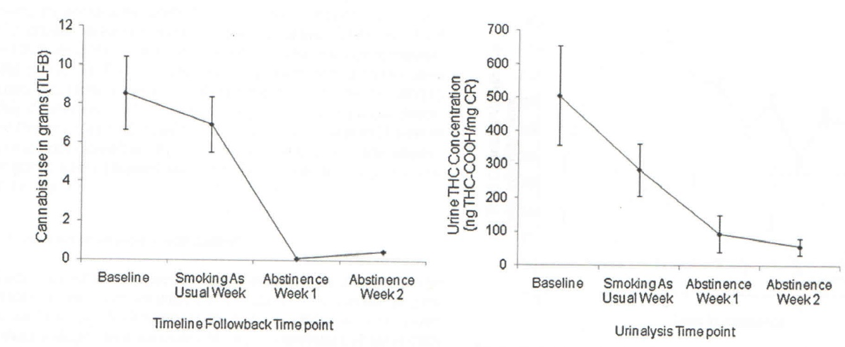
Results:

Slide 8
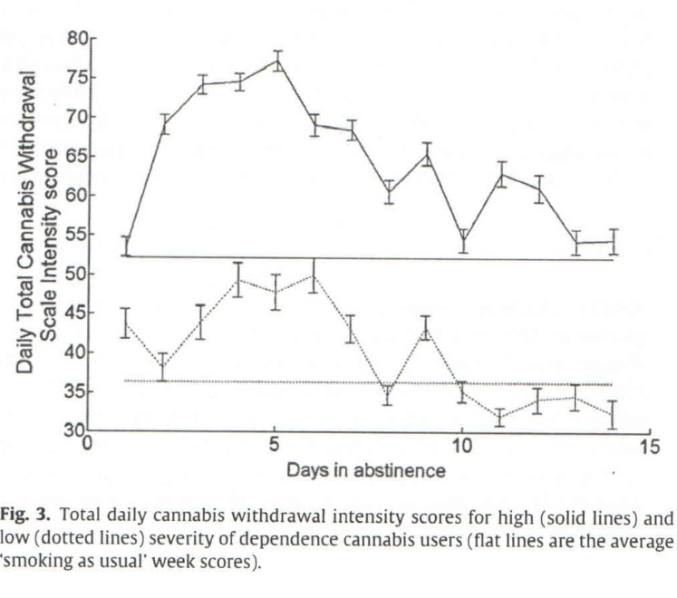
Results:

Slide 9
Consistent Findings: (in descending order)
Sleep disturbance items (highest validity)
Angry outbursts
Feeling irritated
Physical tension
Nausea
Restlessness
Nervousness
Cravings
Depression
Loss of appetite
Headaches
Stomach ache
Intensity of withdrawal was less important than degree of associated distress

Slide 10
Conclusion:
Yes! There is a withdrawal syndrome!
…….and it helps drive addiction!

