Slide 1
Are you taking care of both parts of your brain?
Moving toward spirituality/peace

Slide 2
The Big Book’s Been Right All Along Anatomy of the Disease (This doctor’s opinion)
Melissa Lee Warner MD
Wm J Farley Center @ Williamsburg Place
800.582.6066

Slide 4
Addiction Is
Brain disease (NIH)
Primary
Characterized by dysregulation of specific neurochemical mechanisms in reward and stress circuits
(Barthwell; FSAM 2006)

Slide 5
The doctor’s theory that we have an allergy to alcohol interests us. (AA; The Doctor’s Opinion)
…the action of alcohol on these chronic alcoholics is a manifestation of an allergy…the phenomenon of craving is limited to this class and never occurs in the average temperate drinker
(Doctor’s Opinion)

Slide 6
Allergy
Abnormal Reaction
Joe & Charlie
of Mesolimbic System (Mid-brain)
Normal Reaction to Intoxicants
Abnormal Reaction

Slide 7
Limbic Brain
…where our instinctual drives and abilities to express emotion and pleasure reside. (Brick & Erickson 1998)
Creation gave us instincts for a purpose…
harvest food
construct shelter
reproduce
social instinct
(Twelve Steps and Twelve Traditions; StepIV; p.42)

Slide 8
Instincts (Twelve Steps and Twelve Traditions; StepIV, pp.42-50)
…perfectly necessary and right, and surely God-given
…our great natural assets, the instincts, have turned into physical and mental liabilities
…instincts run wild in themselves is the underlying cause of their destructive drinking
… instincts gone astray, have been the primary cause of his drinking

Slide 9
Instincts (Twelve Steps and Twelve Traditions; StepVIII, p. 80)
…instincts in collision, which cause physical, mental, emotional, or spiritual damage….

Slide 10
Limbic Brain …where our instinctual drives and abilities to express emotion and pleasure reside. (Brick & Erickson 1998)
Instinctual Drives
Maslow’s Hierarchy of Needs
Paramount to Survival
Pleasure/Emotion
Intoxication
Mammals get High

Slide 11
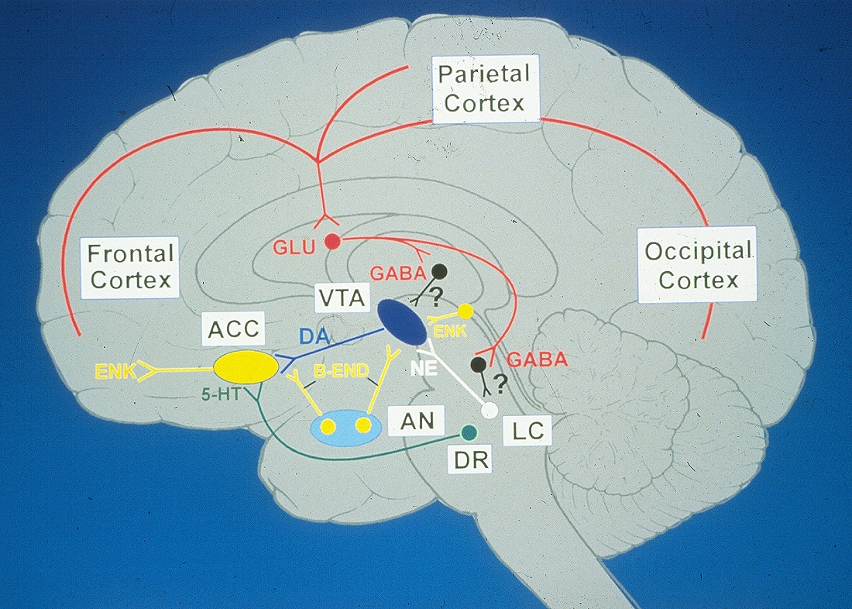
Addiction Is
Brain disease
(NIH)
Characterized by dysregulation of specific neurochemical mechanisms in reward and stress circuits
(Barthwell; FSAM, 2006)

Slide 12
Nuclei of the Mesolimbic System
Ventral tegmental area drug-induced reward (high)
Nucleus accumbens- James Brown nucleus (Sex/Drugs/Rock&Roll)
Functions to alert and motivate when the opportunity presents itself to obtain something desirable (McCance-Katz)
Orbitofrontal Cortex
Controls impulses to seek gratification when they are out of line with overall goals (McCance-Katz)
Amygdala
Establishing learned associations between motivationally relevant events and neutral stimuli that signal events (McCance-Katz)
Locus Coeruleus
Physical Dependence/ Withdrawal

Slide 13
…where our instinctual drives and abilities to express emotion and pleasure reside. (Brick & Erickson 1998)
Addictive Diseases are Intoxicant Use Disorders
Allergy Abnormal Reaction
Limbic Brain Directs/ Over-rides the Thinking Brain
Pathological usurpation (S. Hyman MD)
… in alcoholics the will is amazingly weakened when it comes to combating liquor, though it often remains strong in other respects.
(AA; Bill’s Story, p.7)

Slide 14
Limbic Brain
…where our instinctual drives and abilities to express emotion and pleasure reside. (Brick & Erickson 1998)
Creation gave us instincts for a purpose…
harvest food
construct shelter
reproduce
social instinct
(Twelve Steps and Twelve Traditions; Step IV; p.42)

Slide 15
Limbic (Reptile) Brain
FOUR F’s
Feeding
Fighting
Fornicating
Fear
HALT

Slide 16
FEAR
Driven by a hundred forms of FEAR, self-delusion, self-seeking, and self-pity….
(AA; p. 62)
(fear)…touches about every aspect of our lives. It was an evil and corroding thread; the fabric of our existence was shot through with it
(AA; Step IV, p.67)

Slide 17
Fear
Excitement
Spiritus/Breath

Slide 18
Craving
“An intense and prolonged, desire, yearning or appetite”
Webster’s New World Dictionary
Craving is a major component of Addiction….a major contributor to relapse (Eliot L Gardner PhD, NIDA)

Slide 19
Craving
…the phenomenon of craving is limited to this class and never occurs in the average temperate drinker
(Doctor’s Opinion)
…they were drinking to overcome a craving beyond their mental control
(Doctor’s Opinion)
Limbic vs. Cerebral
Pathological usurpation

Slide 20
Nuclei of the Mesolimbic System
Ventral tegmental area drug-induced reward (high)
Nucleus accumbens- James Brown nucleus (Sex/Drugs/Rock&Roll)
Functions to alert and motivate when the opportunity presents itself to obtain something desirable (McCance-Katz)
Orbitofrontal Cortex
Controls impulses to seek gratification when they are out of line with overall goals (McCance-Katz)
Amygdala
Establishing learned associations between motivationally relevant events and neutral stimuli that signal events (McCance-Katz)
Locus Coeruleus
Physical Dependence/ Withdrawal

Slide 21
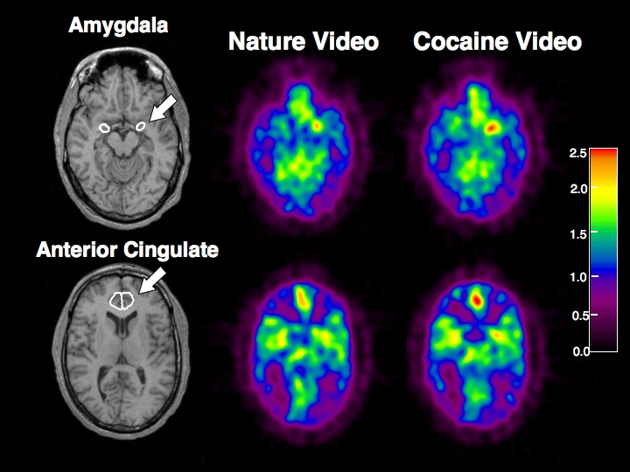

Slide 22
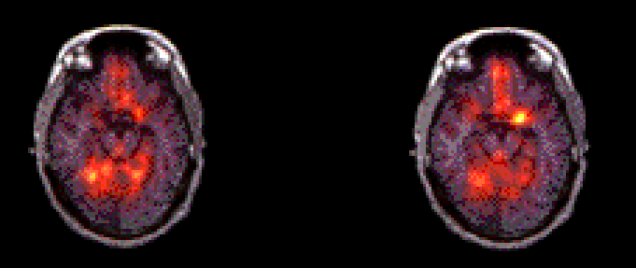
The Memory of Drugs
Amygdala not lit up
Amygdala activated
Front of Brain
Back of Brain
Nature Video
Cocaine Video

Slide 23
Craving incubates with the passage of time (Eliot L Gardner PhD, NIDA)
It is easy to let up on the spiritual program of action and rest on our laurels. We are headed for trouble if we do, for alcohol is a subtle foe. We are not cured of alcoholism. What we really have is a daily reprieve contingent on the maintenance of our spiritual condition. (AA; p.85)

Slide 24
Brain disease with a Spiritual solution
Having had a spiritual awakening as
the result of these steps…. (StepXXII)

Slide 25
Spiritual Remedy (AA; p. 39)
To be doomed to an alcoholic death or live on a spiritual basis are not always easy alternatives to face. (AA; We Agnostics)
But after a while we have to face the fact that we must find a spiritual basis of life- or else. (AA; We Agnostics)
For most cases, there is virtually no other solution (AA; p.43)
…unless this person can experience an entire psychic change there is little hope of his recovery.(AA; The Doctors Opinion)

Slide 26
Spiritual Experience
…relieved of his drink obsession by a sudden spiritual experience (AA; Forward to Second Edition)
…vital spiritual experiences….in the nature of huge emotional displacements and rearrangements (Carl Jung)(AA; p. 27)
…he has undergone a profound alteration in his reaction to life
…tapped an unsuspected inner resource
…awareness of a power greater than ourselves is the essence of the spiritual experience
(AA; Appendix II)

Slide 27
Spiritual Experience (con’t)
…we have had deep and effective spiritual experiences which have revolutionized our whole attitude toward life, toward our fellows and towards God’s universe
(AA; p. 25, There is a Solution)
…but now we begin to have a spiritual experience….We feel we are on the Broad Highway, walking hand in hand with the Spirit of the Universe. (AA; p. 75)
Step V promises

Slide 28
1st Step Concern: Powerlessness
Individuals getting sober for the first time are, by definition, unable to know how incredibly difficult it is to maintain long-term sobriety. (Particularly if detected in the earlier stages.)
Highly competent individuals are at risk to believe that they will be able to conquer addiction once they intend to.

Slide 30
Alcoholics Anonymous, Foreward to Second Ed, xvi. {The miracle}
From this doctor (Silkworth,) the broker (Bill Wilson) had learned the grave nature of Alcoholism.
But when the broker gave him (Bob Smith) Dr. Silkworth’s description of alcoholism and its hopelessness, the physician (Dr Bob Smith) began to pursue the spiritual remedy for his malady with a willingness he had never before been able to muster. He sobered, never to drink again up to the moment of his death….

Slide 31
Working With Others
…begin to dwell on the hopeless feature of the malady.
…talk to him about the hopelessness of alcoholism.
…the more hopeless he feels the better.

Slide 32
Alcoholics Anonymous, Foreward to Third Ed, xxii.
…at its core it remains simple and personal. Each day, somewhere in the world, recovery begins when one alcoholic talks with another alcoholic, sharing experience, strength and hope.

Slide 33
How It Works
If you have decided you want what we have and are willing to go to any length to get it….

Slide 34
Two Brains
Cortex=> Thinking Brain
Limbic=> Reptile Brain

Slide 35
Quieting the Thinking Brain
Serenity

Slide 36
Abraham Lincoln
Pain is inevitable, suffering is optional
Thinking Brain
Worst possible case scenario=> suffering

Slide 37
Thich Nhat Hanh
“Whether the ground beneath our feet is heaven or hell depends entirely on our way of seeing and walking.“
Mindfulness

Slide 38
Bill’s Story
Simple, but not easy; a price had to be paid. It meant destruction of self-centeredness. I must turn in all things to the Father of Light who presides over us all.
… followed by such a peace and serenity as I had never known…. I felt lifted up, as though the great clean wind of a mountain top blew through and through.

Slide 39
How It Works Step III
Selfishness - self-centeredness! That, we think, is the root of our troubles….
As we felt new power flow in, as we enjoyed peace of mind….
…as we became conscious of His presence, we began to lose our fear of today, tomorrow or the hereafter.
{Yesterday is history, tomorrow’s a mystery, today is a gift. That’s why we call it The Present}
Mindfulness

Slide 40
How It Works Step IV
Resentment is the “number one” offender. It destroys more alcoholics than anything else. From it stem all forms of spiritual disease (suffering.)
…leads only to futility and unhappiness (suffering.)
When harboring such feeling, we shut ourselves off from the sunlight of the Spirit.

Slide 41
Freedom From Bondage “If you have a resentment you want to be free of,…pray….”
I pray for___
“…you will be free.”
I ask that everything I want for myself be given to them
“…you will be free.”
I ask for their health, their prosperity, their happiness
“ and you will be free.”
“Even when you don’t really want it for them, and your prayers are only words and you don’t really mean it, go ahead and do it anyway.”
{End your suffering}

Slide 42
Into Action Step IX
“How can I best serve thee- Thy will (not mine) be done” (Prayer)
Those are the thoughts which must go with us constantly {directions.}
…we ask God (Prayer) to direct our thinking, especially asking that it be divorced from self-pity, dishonest or self-seeking motives.
We ask (Pray) especially for freedom from self-will.
As we go through the day we pause, when agitated or doubtful, and ask (Pray) for the right thought or action.
Step IX promise: …we will know peace.

Slide 43
Into Action Step X We have entered the world of the Spirit
Continue to watch for selfishness, dishonesty, resentment and fear
When these crop up we ask God at once to remove them.(Pray)
We discuss them with someone immediately and make amends quickly if we have harmed anyone.
Then we resolutely turn our thoughts to someone we can help.
Step X promise: And we have ceased fighting anything or anyone….

Slide 44
Quiet your Brain Other Prayers
Step III, VII & XI
Serenity
Dear Lord; It’s Your’s

Slide 45
…praying only for knowledge of His will for us and the power to carry that out. (Step XI)
“ Thy will (not mine) be done” (Twelve and Twelve Step II)

Slide 46
Doctor, Alcoholic, Addict
Perhaps the best thing of all for me is to remember that my serenity is inversely proportional to my expectations.

Slide 47
Doctor, Alcoholic, Addict
And acceptance is the answer to all my problems today. When I am disturbed, it is because I find some person, place, thing, or situation- some fact of my life- unacceptable to me, and I can find no serenity until I accept that person, place, thing, or situation as being exactly the way it is supposed to be at this moment. Nothing, absolutely nothing happens in God’s world by mistake. Until I could accept my alcoholism, I could not stay sober; unless I accept life completely on life’s terms, I cannot be happy. I need to concentrate not so much on what needs to be changed in the world as on what needs to be changed in me and in my attitudes.
{I hope the problem is me.}
Acceptance= Respond favorably

Slide 48
Working With Others Step XII
…{italics} we have stopped fighting anybody or anything. We have to!

Slide 49
How It Works Step III Prayer
Relieve me of the bondage of self…
Suffering

Slide 50
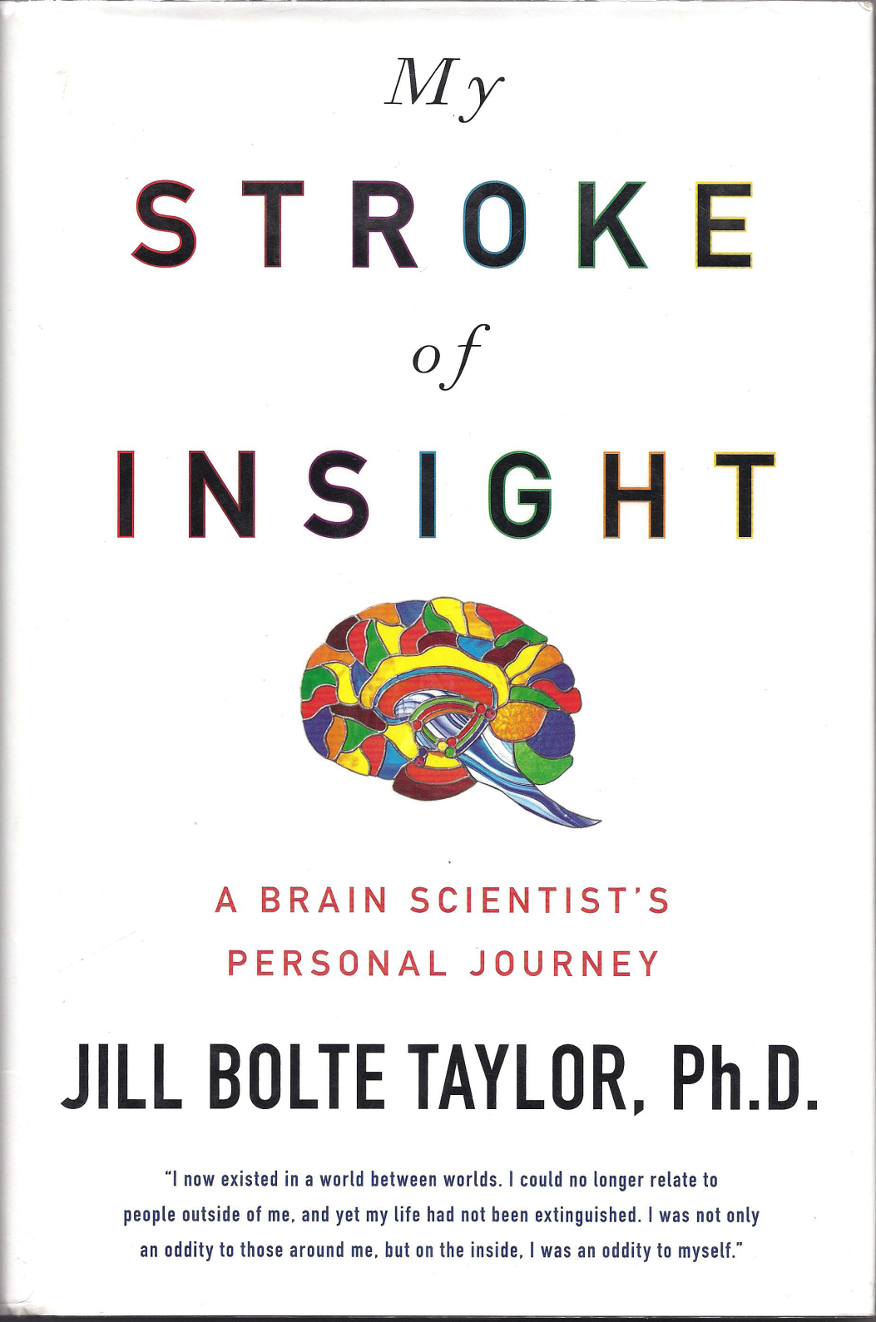

Slide 51
My Stroke of Insight Jill Bolte Taylor PhD
a growing sense of peace
enfolded by a blanket of tranquil euphoria
Energy of your spirit flowing like a great whale gliding through a sea of silent euphoria
dwelling in a flow of sweet tranquility
Unforgettable sense of peace pervade your entire being and feel the calmness

Slide 52
My Stroke of Insight Jill Bolte Taylor PhD
The life force energy within each of us contains the power of the universe
being at one with the universe, experience the perception of connection to all that is
A being of light radiating life into the world; perfect, whole, beautiful just the way you are
Deep within your heart’s consciousness rests eternal peace
The easiest way to humble yourself back into a state of peaceful grace is through the act of gratitude
Walk in genuine compassion, consider another’s circumstance with love rather than judgement
Shift back into your natural state of joy

Slide 53
Alcoholics Anonymous
…we are delighted. We can look the world in the eye. We can be alone at perfect peace and ease. Our fears fall from us. We begin to feel the nearness of our Creator….We feel we are on the Broad Highway, walking hand in hand with the Spirit of the Universe.
We are going to know a new freedom and a new happiness. We will not regret the past nor wish to shut the door on it. We will comprehend the word serenity and we will know peace. No matter how far down the scale we have gone, we will see how our experience can benefit others. That feeling of uselessness and self-pity will disappear. We will lose interest in selfish things and gain interest in our fellows. Self-seeking will slip away. Our whole attitude and outlook upon life will change. Fear of people and of economic insecurity will leave us. We will intuitively know how to handle situations which used to baffle us. We will suddenly realize that God is doing for us what we could not do for ourselves.
Abandon yourself to God as you understand God. Admit your faults to him and to your fellows. Clear away the wreckage of your past. Give freely of what you find and join us. We shall be with you in the fellowship of the Spirit, and you will surely meet some of us as you trudge the Road of Happy Destiny. May God bless and keep you until then.

Slide 54
Traveling Mercies, Anne Lamott p107
…they (Buddists) believe when a lot of things start going wrong all at once, it is to protect something big and lovely that is trying to get itself born- and that this something needs for you to be distracted so that it can be born as perfectly as possible.

Slide 55
Quiet Your Brain
Power of Now, Eckardt Tolle
Audio
Brainsync.com
Bi-neural feedback
The Secret Universal Mind Meditation II

