Slide 1
Review Three Major Considerations of Addiction Treatment I. Project Match II. Blue Print Project III. Medication Assisted Treatment
Burns M. Brady, MD,. FASAM, FAAFP

Slide 2
I. Project Match
A. This study was an 8 year multisite project sponsored by the National Institute on Alcohol Abuse and Alcoholism (NIAAA) at a cost of $27 million dollars.
Match studied whether treatment should be uniform or assigned to patients based on specific needs and characteristics.
Three types of treatment were investigated
All types were administered by psychotherapists
1. Cognitive Behavioral Coping Skills Therapy – focus on correcting poor self-esteem and distorted, negative, and self-defeating thinking
2. Motivational Enhancement Therapy – focus on helping patients to become aware of and build on personal strengths that can help improve readiness to quit.
3. Twelve Step Facilitation – focus on helping to familiarize patients with the AA philosophy and to encourage participation
This study concluded that patient treatment matching is not necessary because the three techniques are equal in effectiveness

Slide 3
I. Project Match
B. A complete review of the literature would be recommended to appreciate the furor and spectrum of responses – pro and con

Slide 4
I. Project Match
C. Journal of Studies on Alcohol and Drugs (online) January 2015
Psychiatric Severity
Neither treatment was superior for patients with higher levels of psychiatric severity
Patients low in psychiatric severity had more abstinent days after Twelve Step facilitation and Twelve Step participation

Slide 5
II. Blueprint Project
How are addicted physicians treated?
A national survey of Physician Health Programs
Journal of Substance Abuse Treatment July 2009
A. Physicians with SUD receive care that is qualitatively different from and more effective than that offered to the general population
This care is supervised/administered by PHP’s. 49 states have such a program. Mission: to promote
1. early detection
2. assessment
3. evaluation
4. referral to abstinence oriented (usually) residential treatment 60-90 days duration
5. 12 Step oriented outpatient. Follow up
6. contract 5 years
Recovery rate (44 programs responding) 78% for 1-2 years --- 89% continuous sobriety for 5 years

Slide 6
I. Blueprint Project
B. Follow up study
Six Lessons from State PHP’s to Promote Long-Term Recovery
J. Psychoactive Drugs, 2012 Jan-March
1. zero tolerance for any use of alcohol and drugs
2. thorough evaluation and patient focused care
3. prolonged, frequent random testing for both alcohol and other drugs
4. effective use of leverage
5. defining and managing relapses
6. goal of lifelong recovery rooted in the 12 Step fellowship
Elements of this model are in place for virtually all health care boards. Also in drug courts (family and individual) as well as pilots, attorneys, and clergy

Slide 7
III. Medication Assisted Treatment MAT
A. Review neuropharmacology and reward center with consideration of medications recommended or used in addiction treatment

Slide 8
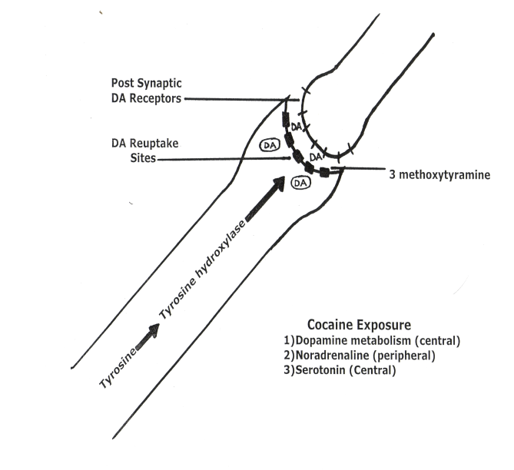
Neuropharmacology

Slide 9
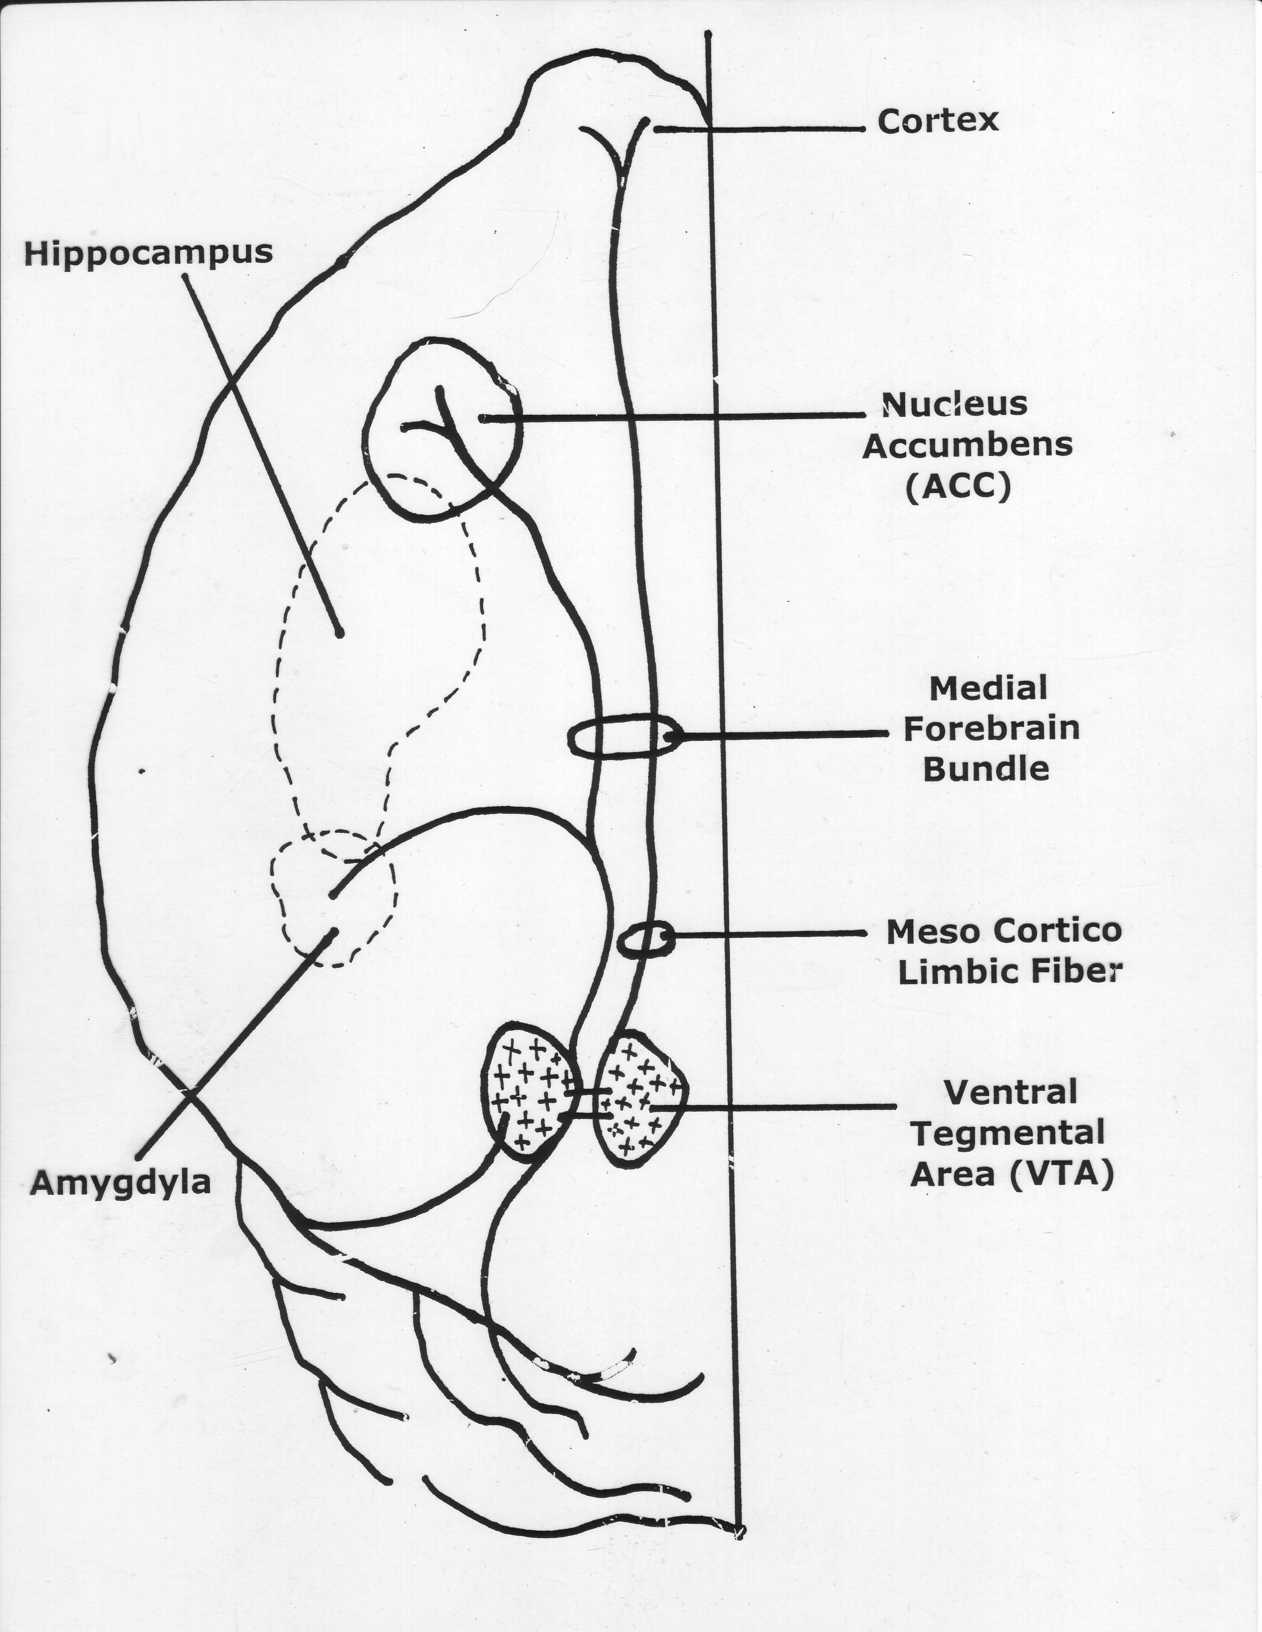

Slide 10
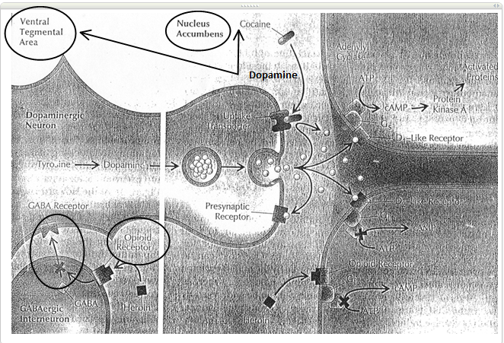

Slide 11
NEUROTRANSMITTORS
I. Single Amino Acid Receptors Acaprosate
AMPA
90% A. Glutamate KA
NMDA
B. GABA GABA_{A} Gabapentin (Neurontin)
Alcohol GABA_{B} Pregabalin (Lyrica)
BZ
Sedative Hypnotic withdrawal
II. Neuropeptides (Narcotics) Receptors MU Buprenorphine 8% A. Endorphin – Beta Kappa Methadone
B. Enkeflin Delta Naltrexone
C. Dynorphin Orphan (Vivatrol)
D. Orphanin

Slide 12
III. Aminergics
8% A. Dopamine Receptors
(Alcohol, Cocaine, Pot, D₁ D₂ D₃ D₄ D₅
Narcotics, Nicotine)
B. Serotonin Receptors
(SSRI Drugs) withdrawal effect 5HT3 5HT2 5HT1A
C. Acetyl Choline Receptor
(Nicotine, Pot) Nicotinic AC Chantix
D. Noradrenaline (Alcohol, Combination SSRI)
Effexor
IV. Neurosteroids Cholesterol
Godanal Hormones
GABA_{A}
NMDA

Slide 13
Table 3. Overview of Major Neurotransmitters: Functions and Alcohol-Related Behaviors
Neurotransmitter General Function Specific Action by Alcohol Alcohol-Related Function
_________________________________________________________________________________________________________
Dopamine (DA) Regulates motivation, Initiates a release at the NAC either Mediates motivation and reinforcement and fine directly or from projections via the reinforcement of alcohol
motor control mesolimbic system from the VTA consumption. Drugs that
increase DA are drugs of reward.
PET scan – D₂ receptor and transporter (↑density) relapse
______________________________________________________________________________________________________________________________
Serotonin (5-HT) Regulates bodily rhythms, The brain 5-HT system may modulate May influence alcohol consumption,
appetite, sexual behavior, alcohol intake by 2 different mechanisms: intoxication and development of
emotional states, sleep, (1) modulation of the DA-mediated tolerance through 5-HT₁ receptors;
attention and motivation. reinforcing properties of alcohol via 5-HT₂ may contribute to withdrawal
and 5-HT₃ receptors; and (2) suppression symptoms and reinforcement
of alcohol intake by activation of 5-HT_{1A} through 5-HT₂ receptors;
transporter receptors. and may modulate DA release
(reuptake site) through 5-HT₃ receptors,
Type II (Cloninger) thereby increasing alcohol’s
rewarding effects.
______________________________________________________________________________________________________________________________
ƴ-aminobutyric acid Serves as the primary Causes tonic inhibition of dopaminergic May contribute to intoxication and
(GABA) (GABA) inhibitory neurotransmitter projections to the VTA and NAC. sedation; inhibition of GABA in the brain. Prolonged alcohol use causes a down- function following drinking
regulation of these receptors and a may contribute to acute
potential for decreased inhibitory withdrawal symptoms.
ion channels neurotransmission.
chloride influx

Slide 14
Glutamate Serves as the major excitatory Alcohol inhibits excitatory neuro- May contribute to acute withdrawal
neurotransmitter in the brain. transmission by inhibiting both NMDA symptoms; inhibition of glutamate
and non-NMDA(kainite and AMPA) function following drinking
receptors. Up-regulation of these receptors cessation may contribute to
ion channels to compensate for alcohol’s antagonistic intoxication and sedation.
calcium influx effect occurs after prolonged exposure to
alcohol, resulting in an increase in neuroexcitation.
____________________________________________________________________________________________________________________________________________
Opioid peptides Regulates various functions and Alcohol stimulates β-endorphin release Contributes to reinforcement of
produced morphine-like effects, in both the NAC and VTA area. Alcohol consumption, possibly
including pain relief and mood β-endorphin pathways can lead to increased through interaction with DA.
elevation. DA release in the NAC via 2 mechanisms:
(1) β-endorphins can disinhibit the tonic
inhibition of GABA neurons on DA cells in
the VTA area, which leads to a release of DA
in the NAC area; and (2) β-endorphins can
stimulate DA in the NA directly. Both
mechanisms may be important for alcohol
reward.
_
AMPA = α-amino-3-hydroxy-5-methisoxizole-4-propionic acid; NAC= nucleus accumbens;
NMDA = N-methyl-D-aspartate; VTA = ventral tegmentum.
Adapted from Swift RN. Alcohol Res Health. 1999;23:209.18

Slide 15
Biochemistry
Antabuse
Alcohol Acetaldehyde
Alcohol (Acetaldehyde dehydrogenase)
Dehydrogenase
(female effect)
CO₂ + H₂0 Acetic Acid
Acetaldehyde Dehydrogenase I and II
Populations affected
1) Native American
2) Oriental

